Slide 1

CodeSeeker
INSTALL GO LANGUAGE ON UBUNTU

Slide 2
CodeSeeker
Step 1 – Install Go on Ubuntu
Login to your Ubuntu system using terminal and upgrade to apply latest security updates there.
-----> sudo apt-get update
-----> sudo apt-get -y upgrade

Slide 3
CodeSeeker
Now download the Go language binary archive file using following link. To find and download latest version available or 32 bit version go to official download page.( Type bellow command in ubuntu terminal)
-----> wget https://dl.google.com/go/go1.12.7.linux-amd64.tar.gz
Now extract the downloaded archive and install it to the desired location on the system. For this tutorial, I am installing it under /usr/local directory. You can also put this under the home directory (for shared hosting) or other location. (Type bellow command in ubuntu terminal)
-----> sudo tar -xvf go1.12.7.linux-amd64.tar.gz
-----> sudo mv go /usr/local

Slide 4
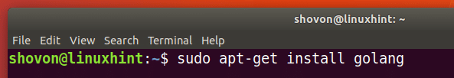
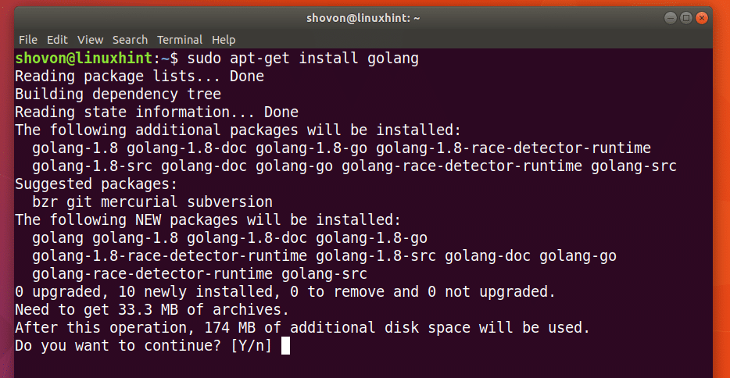
CodeSeeker
Now you can install GoLang, you can run the following command.
----> sudo apt-get install golang
Once you run the command to install the version of GoLang you want, you should see the following prompt. Just press ‘y’ and then press <Enter> to continue.

Slide 5
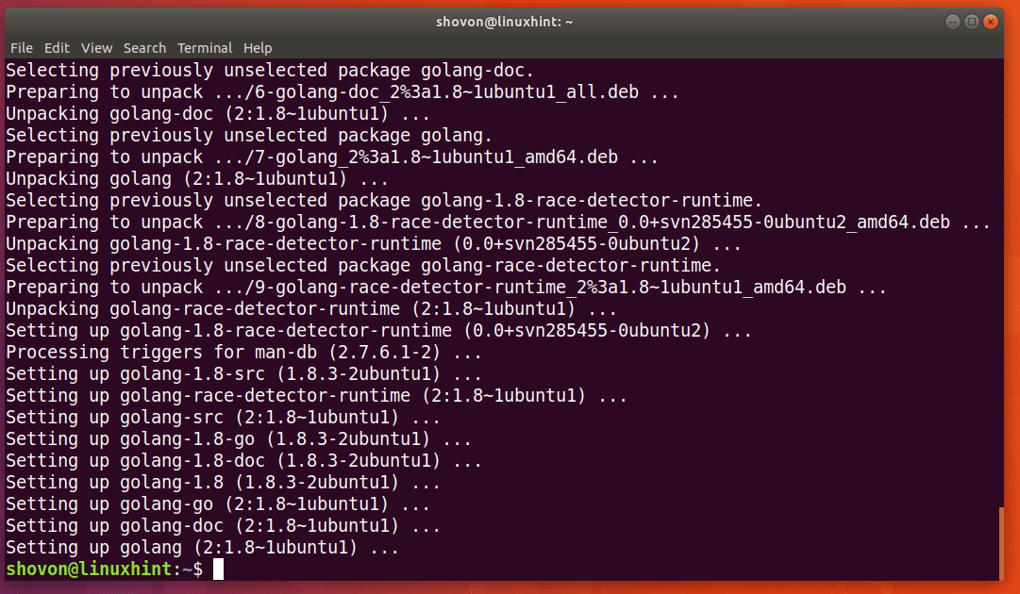
CodeSeeker
GoLang should be installed.

Slide 6
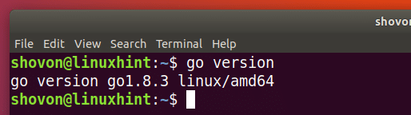
CodeSeeker
Testing GoLang:
Now run the following command to verify that Go commands are accessible.

